Slide 2
Test XXX focuses on young gay men (18-24 years old) that regularly seek out male sexual partners online.
The campaign uses creative and edgy message relevant to the target audience using social media platforms.
APCOM works with several organisations to implement the campaigns in different cities across Asia.

Slide 3
test
BKK

Slide 4
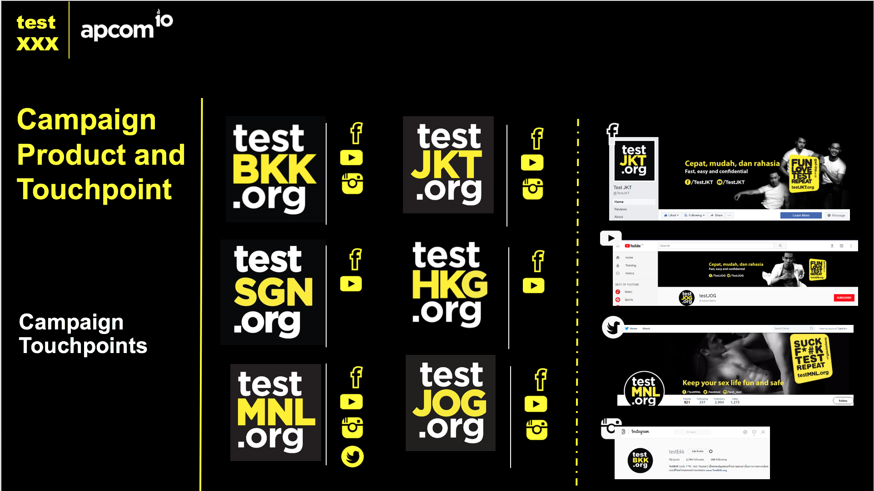
test
BKK

Slide 5
ABOUT TESTBKK
- increase availability of and retention in HIV prevention and care services. - generate demand for HIV counseling and testing services. - improve data collection
2,910 daily reach on Facebook and 9K web visitors per month
Strategic partnership with social influencer with a huge following of MSM (Trasher Bangkok, Blued Thailand, LINE TV, gCircuit, White Party Bangkok, The Gay Passport
/TestBKK
/TestBKK

Slide 6
DIFFERENT WAYS OF DOING:
test
BKK
One click for all clinics
Structured and community-friendly one-stop online hub
Powerful collaborations with key non-health sectors affecting MSM
Multifaceted online paid and guerilla marketing
Companion of research component
/TestBKK
/TestBKK

Slide 7
test
BKK
EXECUTING ONLINE ACTIVITIES
social
media
contents
AdWords
ad
ads on
dating
apps
QR
code
TESTMENOW.COM

Slide 8
test
BKK

Slide 9
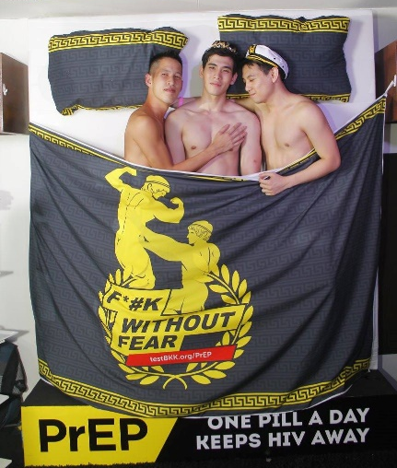
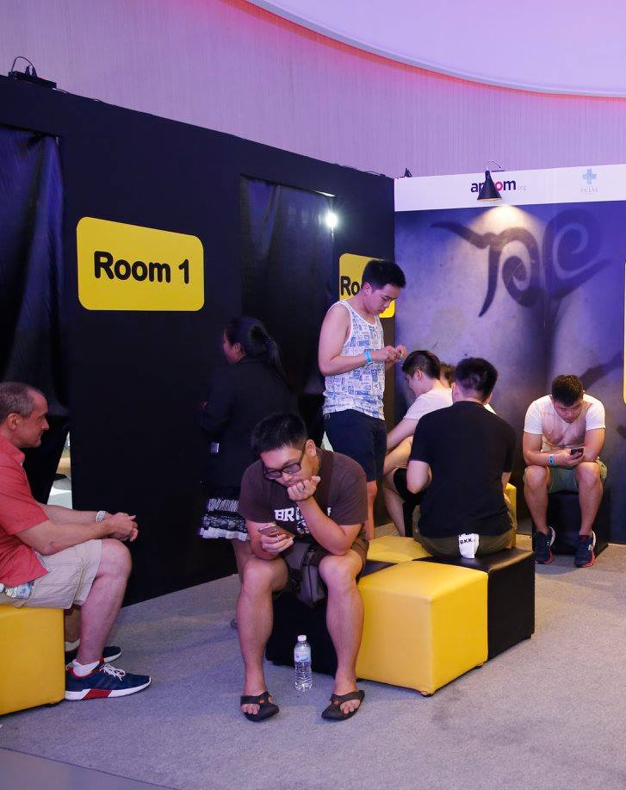
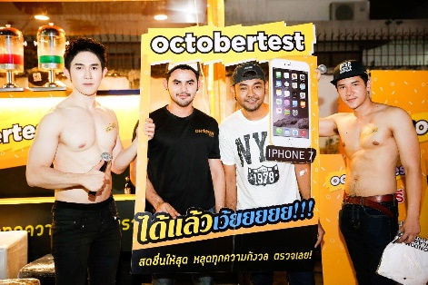
ONLINE TO OFFLINE ACTIVITIES
Pop-up HCT clinic by collaborating with LINKAGES Thailand community partner at key community events/venues:
gCircuit SK (Asia’s largest gay circuit party)
White Party Bangkok (Asia’s largest gay new year party)
OctoberTest (at various gay clubs across Bangkok)

Slide 10
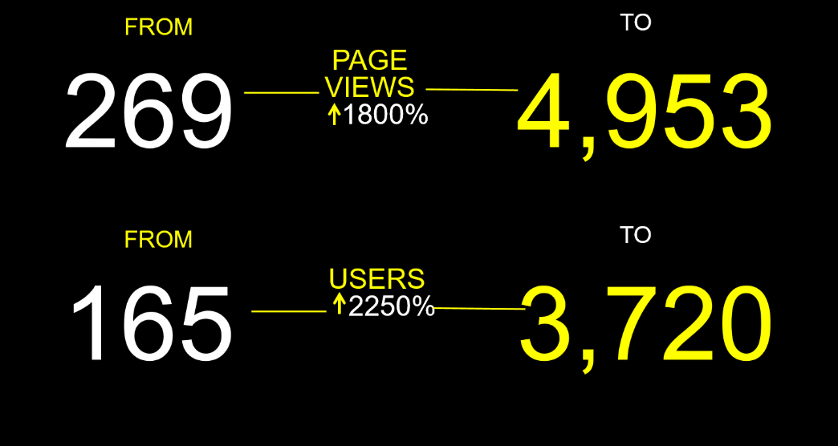
PERFORMANCE
test
BKK
High and constant engagement with young MSM age 18-34 living in Bangkok
Study Case
__________
GAYOK Bangkok
Webseries Season 1
______________
Between the trailer release day and a week after the season finale
98,752

Slide 11
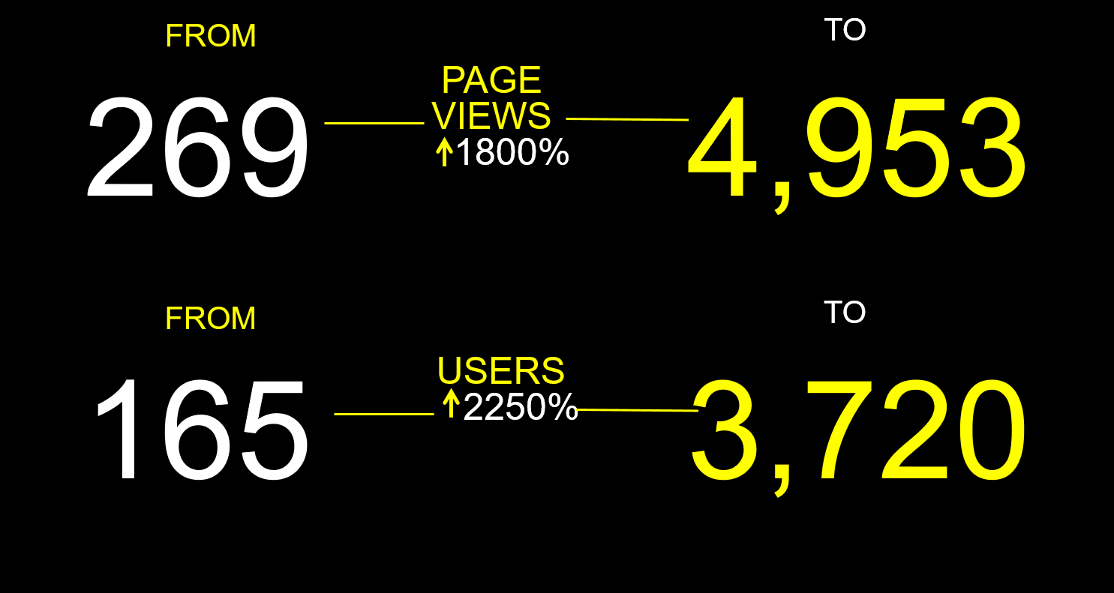
test
BKK
Increased Web Traffic
factored by GAYOK Bangkok Season 1
The Day
of Trailer
Release
The Day
a week after
last episode release

Slide 12
The Roles of CBOs and Partnerships
test
BKK
The message is crafted in a more compelling manner;
Online-to-offline method to reach and recruit YMSM are more effective;
Critical digital and social media engagement are stronger
Partnerships maximise visibility of campaign and access to audience that would otherwise be hard to reach

Slide 13
Counting the numbers
test
BKK
Platform
Type of Online Activity
Key message / Text
Image
Ad
Reactions
Comments
Share
Clicks
2,864,639
Online engagements
As of Q2 2019

Slide 14
THANK YOU!

